Slide 1
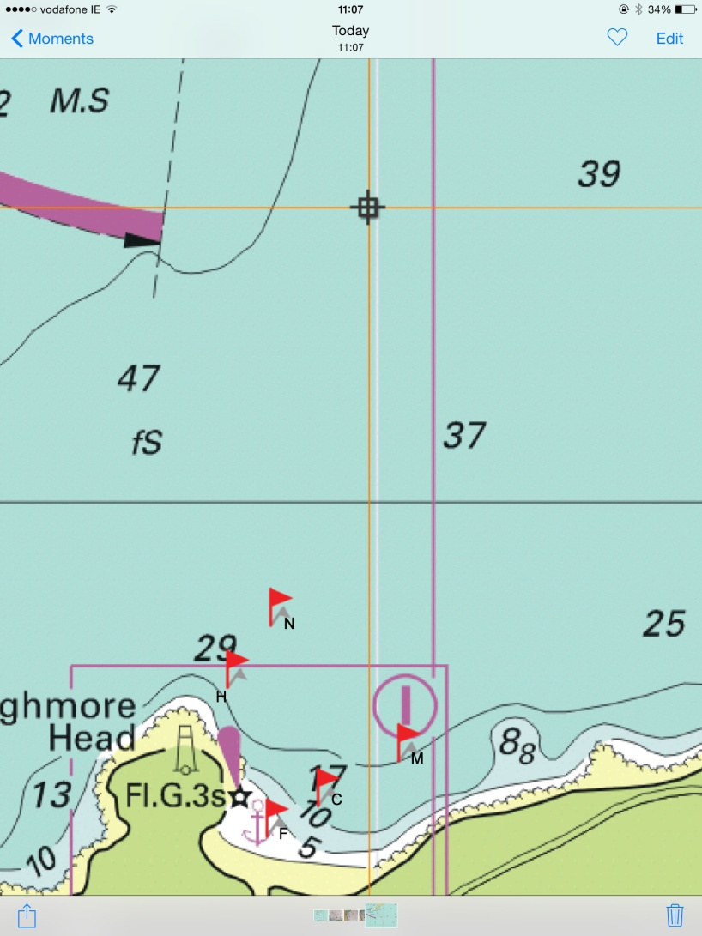
Fixed Racing Mark Coordinates
Centre (C) | 54 27.88N 08 25.70W
Mermaids (M) | 54 28.194N 08 24.73W
North (N) | 54 29.14N 08 26.27W
Head (H) | 54 28.71N 08 26.79W
Finish (F) | 54 27.63N 08.26.53W
Race Fleet and MSC communication on channel 72
Additional marks may be used depending on conditions
Watch out for divers as they use these waters extensively
Avoid Thumb Rock (54 28.32N 8 26.5W)
Fixed marks (C,M,N,H) are large red buoys 1m x 1m
Position of Finish may vary slightly depending on tides

